Slide 1
TradeTree
Team 22: Galileo Black and Jacob Edwards

Slide 2
What is TradeTree?
Website that allows the trading of goods and or services
Allows users to create an account
  Once created, user can list and interact with other listings
Listings of items or services by others offering to trade for another item or service
Has a messaging system to allow users to contact and message each other to discuss trade and meeting agreements.

Slide 3
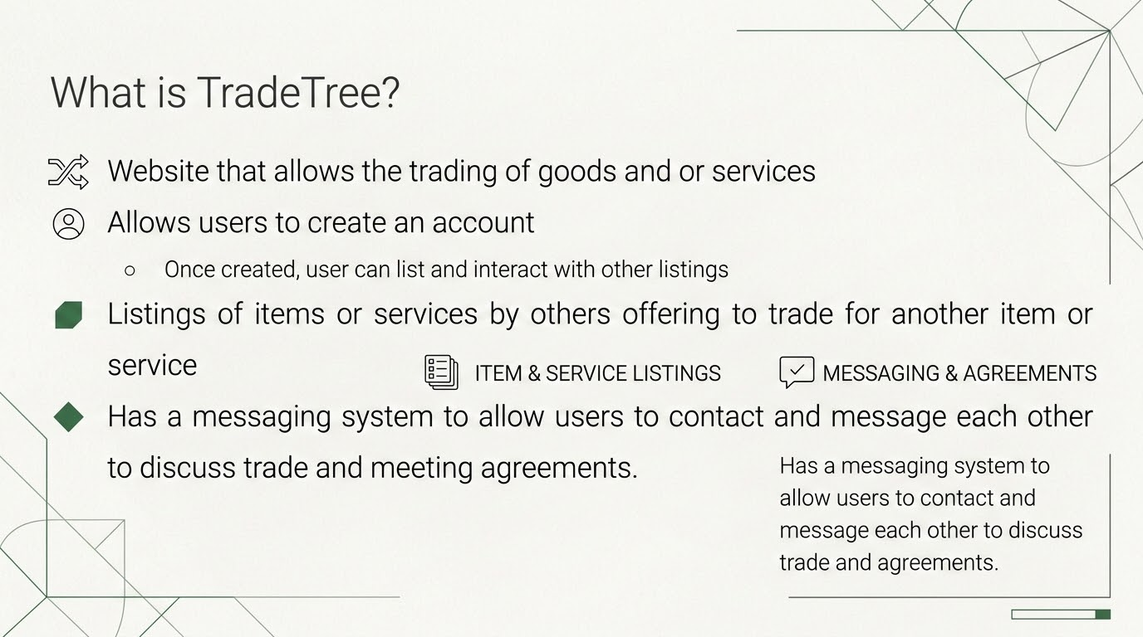

Slide 4
User Profiles
Can list and remove listings they create
Leave reviews with a star rating of another user
Send Tickets (problems or reports) to admins
Able to see the tickets that only they made
  User that the ticket is about will not know about the ticket until after the investigation is finished
    The user the ticket was created about will never know who created the ticket against them to prevent conflicts or retaliations.
  Both users will be notified regarding what the verdict is and what (if any) actions will be taken

Slide 5
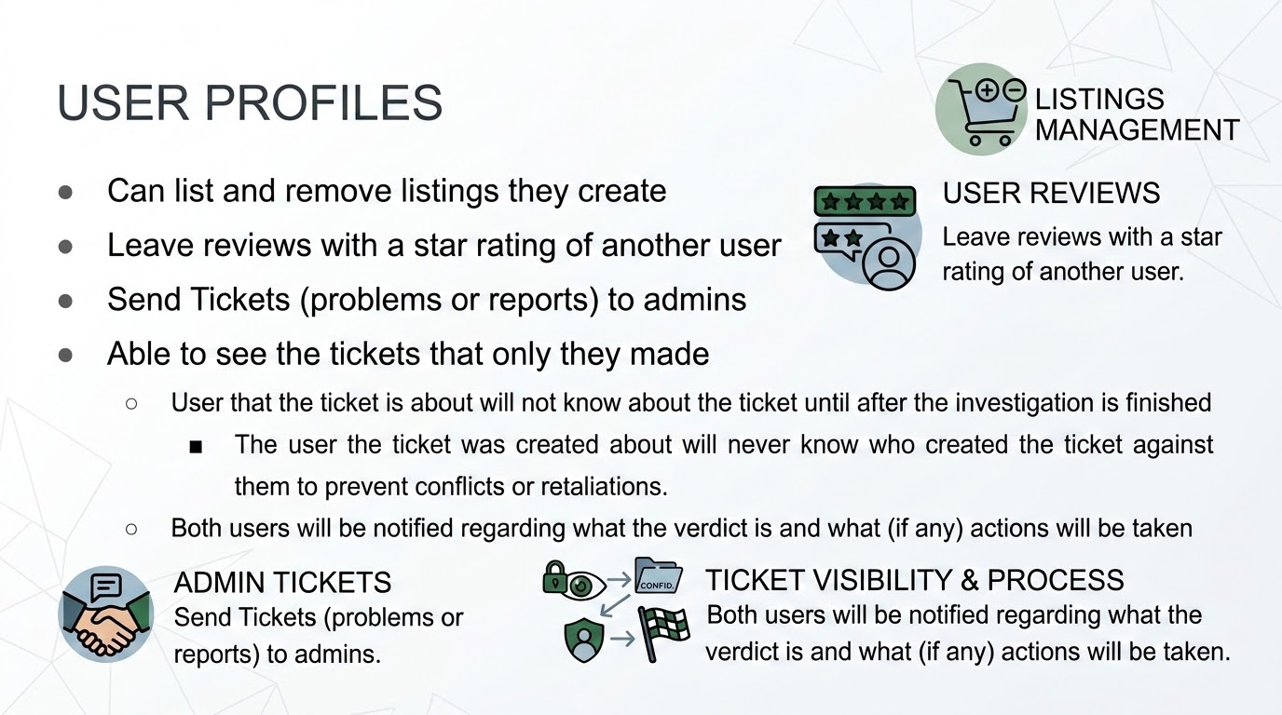

Slide 6
Admin Profiles
Access to remove or edit all listings made in the marketplace
Access to all tickets made by all users
  Only exception are tickets made about that specific admins to prevent tampering of evidence or abuse of power.
Has the same functions and permissions users have
Gets a report of usage statistics at end of month
Admins are roles given to an already made user account that is trusted and monitored by others in the role.
  If an admin abuses power, the role will be revoked or suspended based on infraction.

Slide 7
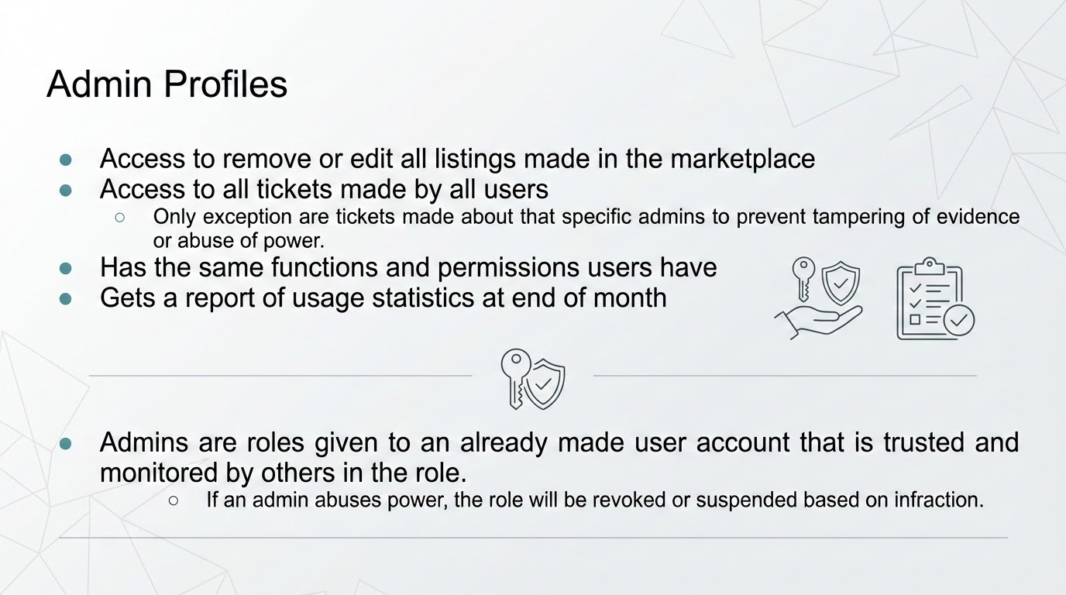

Slide 8
Now, we will transition into the live prototype demo of our site…

